Slide 1
Professional Practices
“The Structure of Organizations”

Slide 2
Organizing an Organization
Organizing is the process of arranging and allocating work, authority and resources among an organization’s members so that they can achieve organizational Goal (Stoner, Freeman and Gilbert).
Organizing is the function of management that involves developing an organizational structure and allocating human resources to ensure the accomplishment of objectives.

Slide 3
Process of Organizing
Division of Work
Grouping of Work
Delegation of Authority
Coordination of Work

Slide 4
Division of Work
An organization comes in to existence when the total task is divided in to the member of groups. Division of work is necessary not only because one individual can not do all the work but specialization results in efficiency and effectiveness.
Henry Fayol stated that an employee is given a specific task to do, they will become more efficient and skilled in it.

Slide 5
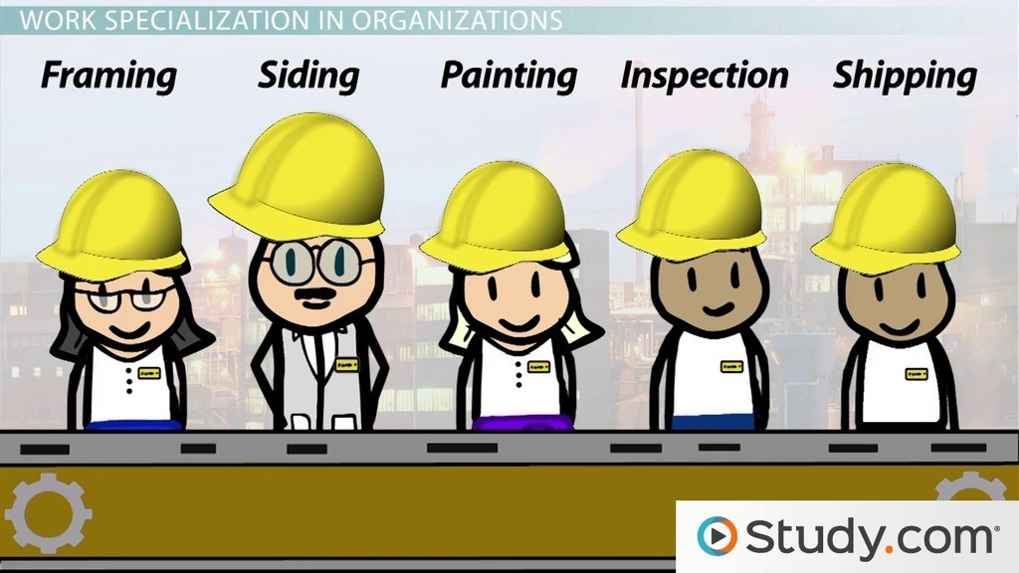

Slide 6
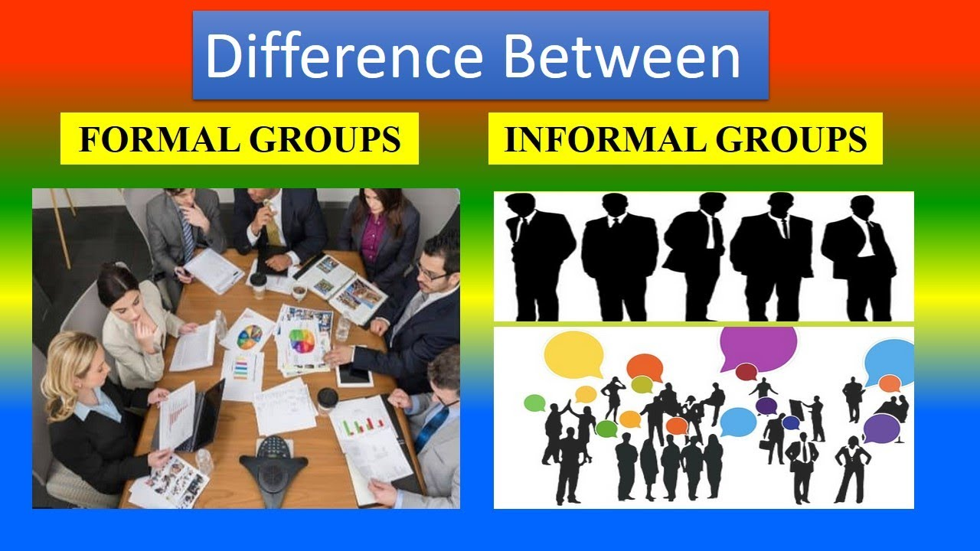
Grouping of Work
The various activities are grouped in departments or division according to similarities and common purpose.

Slide 7
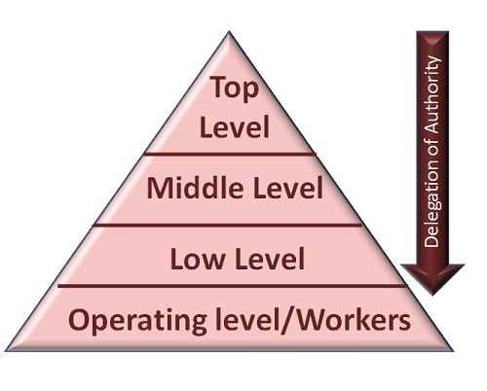
Delegation of Authority
Delegation of authority means division of authority and power downwards to the sub-ordinates.
Delegation of authority can be defined as subdivision & sub-allocation of powers to sub-ordinates in order to achieve effective results.

Slide 8

Coordination of Work
Coordination is the function of management which ensures that different departments and groups work in sync.
Coordination is, thus, "the process of linking the activities of various departments of the organization." Coordination is "the process of integrating the objectives and activities of the separate units, departments or functional areas) of an organization in order to achieve organizational goals efficiently.

Slide 9
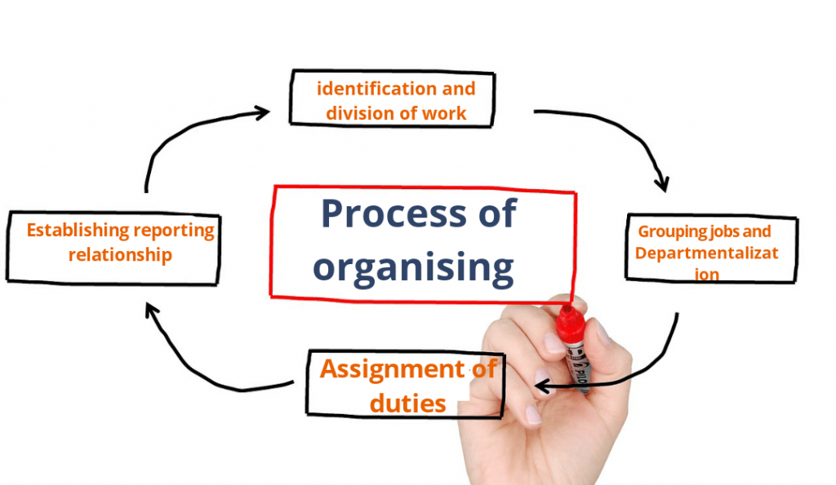
Diagram of Process of Organizing

Slide 10
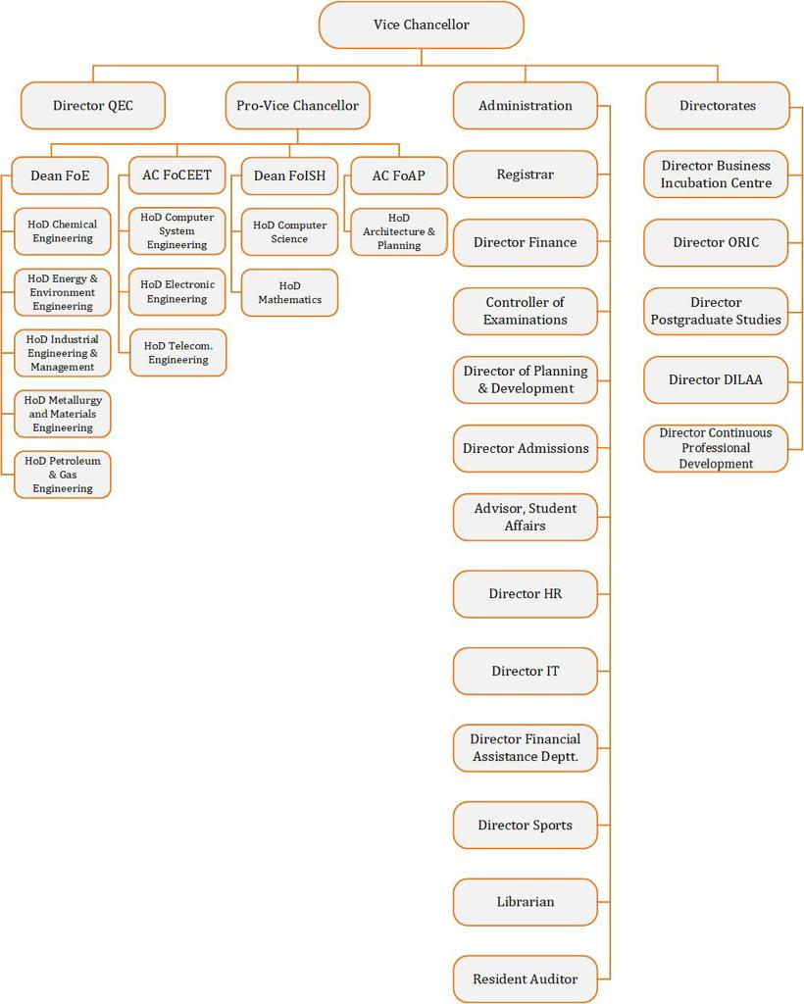
DUET Organizational Chart

Slide 11
Functional Units Areas of an Organization
Tasks carried out in an organization are grouped into major functions
Production: activities that directly contribute to creating the products or services that the company sells.
ICT, Other Business Services, Government services, Transport, Travel and Tourism are the major sub-sectors of Services of Pakistan.

Slide 12
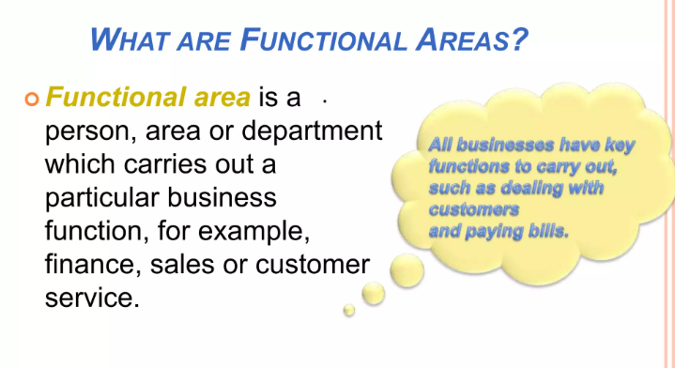

Slide 13
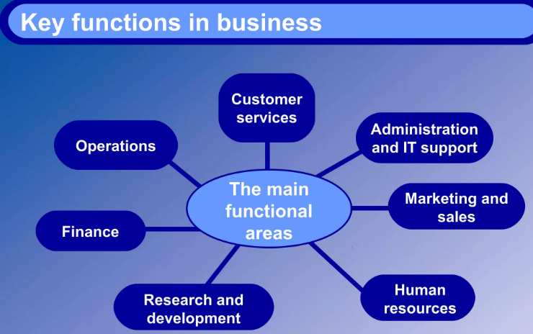

Slide 14
Functional Units of an Organization
Sales and Marketing: sales is concerned directly with selling the product while marketing is concerned with establishing the environment in which product is sold.
Finance and Administartion: every company needs to pay its bills, to look after its funds, to pay its employees and so on....data processing and legal department are also generally included in this function.
Notes:
Marketing consists of all that a company does to identify customers’ needs and design products and services that meet those needs. The marketing function also includes promoting goods and services, determining how the goods and services will be delivered and developing a pricing strategy to capture market share while remaining competitive.

Slide 15
Functional Units of an Organization
Research and Development: how can company do better the things that it is already doing and what other things can be done to raise profits.

Slide 16
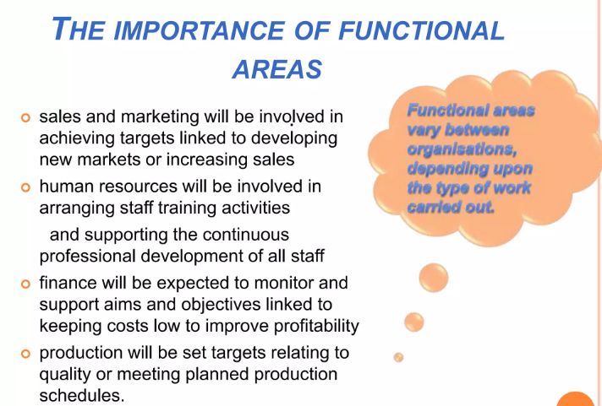

Slide 17
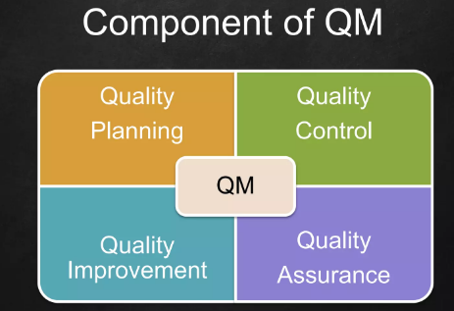
Functional Units of an Organization
Quality Management (QM): It is a process that ensure the quality of product and services through out its life cycle.
QM has four main components: quality planning, quality assurance, quality control and quality improvement.
Notes:
Quality Control Planning is the first step: requirements must be identified, a criteria to be set, and important procedure must be recognized.
Quality Control needed to review the quality of product or service. Inspection and testing is necessary to identify problems and defect that need correction.
Quality assurance: Company needs to assure the defect / mistake are avoided.
Quality Improvement: there is always room for improvement. Need to input valuable suggestions / recommendations.

Slide 18
Position of Quality Management
Whatever be the structure of an organization, the factor of “Quality” should be kept at the center.
Pressures on production and sales create temptation to skimp on quality procedures.
It can only be avoided by developing a “Quality Culture” within the organization.
Notes:
What is quality culture, japanese success.

Slide 19
Position of Quality Management
Some national and international standards are set, which lay down in detail the requirements which a quality plan must meet.
Examples are British Standard 5750 and ISO 9000.

Slide 20
Centralization vs Decentralization
Organizations can be centralised, decentralised and both.
In a centralised organization, many of the detailed operational decisions are taken at the center.
In a decentralised organization, as many details as possible are settled at local level.
Notes:
Advantages/disadvantages

Slide 21
Centralization refers to the concentration of management and decision-making power at the top of the organizational hierarchy for the purpose of coordinating financial, human, and other business resources. In centralized organizations, strategic planning, goal setting, budgeting, and talent deployment are typically conducted by a single, senior leader or leadership team.
However, decentralized organizations, formal decision-making
power is distributed across multiple individuals or teams.

